Slide 1
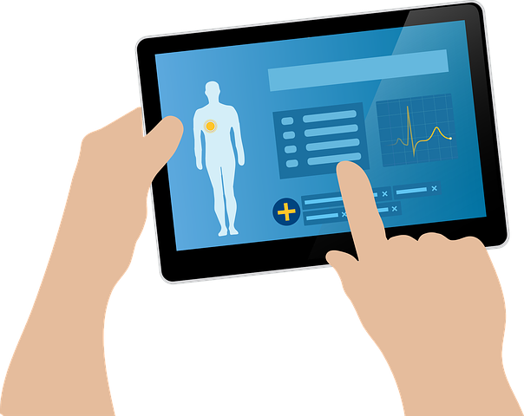
MEDICAL TERMINOLOGY

Slide 2
DEFINATION
Medical terminology is language used to precisely describe the human body including its components, processes, conditions affecting it, and procedures performed upon it.

Slide 3
OBJECTIVE
To analyze words structurally
To correlate and understand word elements with the basics of anatomy , physiology and diseases of human body
To pronounce and write correct spelling of medical terms

Slide 4
Sources
ANGLO –SAXON ( OLD ENGLISH )
Mostly anatomical terms from old english.
Eg.Arm,Back, Bladder, blood, cheek, chest, ear, finger, nose, thumb etc.
GREECO – ROMAN ( GREEUK AND LATIN)
Words are from greek and latin language
Marrow: ( from Medulla), Crani: skull, Cerebro : Brain, Rhin: Nose, Pneumo : Lungs , air
ARABIC
Words are used to describe chemical substances
Alcohol: something subtle, Sharab: Sweet Beverage
MODERN GERMAN
Derived from French
Fahrenheit for thermometer,

Slide 5
Sources
COLORS
Colour | Medical terms | Examples
White | Albus / leukos | Leukocytes
Red | Erythros | Erythrocyte
Brown | Cirrhos | Cirrhosis
Yellow | Xanthos | Xathoma
NUMERALS
Numerals | Medical terms | Examples
Half | Hemi | Hemi plegia
First | Primus | Primigravida
Two | Duo | Duodenum

Slide 6
ELEMENTS OF MEDICAL TERMS
ROOT : foundation of the word
gastr/ic
Root( stomach)
SUFFIX: Word ending
gastr/ itis suffix( inflammation)
PREFIX: Word beginning
epi/gastr/ic
prefix( above)

Slide 7
PREFIXES
Prefixes are frequently found in general language (ie, autopilot, submarine, tricycle), as well as in medical and scientific terminology.
Not all medical terms have prefixes.
A prefix consists of one or two syllables placed before a word to modify its meaning.
Syllables are either prepositions or adverbs

Slide 8
Examples of prefixes
PREFIX | MEANING | EXAMPLE
Mono-, uni- | One | Unilateral
Bi- | Two | Bilateral
Tri- | Three | Triplicate
Hyper | excess | Hyperacidity
hypo | below | Hypoglycemia
Inter | Between | Intercostal
Ab- | Away from | Abduction
Ad- | Toward | Adduction
Ecto-, exo- | Outside | Ectoparasite
Endo- | Inside | Endoderm
Epi- | Upon | Epicondrium

Slide 9
Exercise for prefix
Infra- | Below or beneath
Inter- | Between
Intra- | Within, inside
Intro- | Into, or within
Macro- | Large
Micro-, micr- | Tiny, small
Post- | After, or following, behind
Pre-, pro- | In front of, before, preceding
Retro- | Behind, backward
Semi- | Half
Trans- | Through or across
Tri- | Three
Ultra- | Excessive, beyond

Slide 10
SUFFIXES
Suffixes refer to a syllable denoting a preposition or adverb attached to the end of a word, root, to modify its meaning.
Many endings are adjectives or nouns
They may be combining forms or pseudo –suffixes
It have been classified according to their meanings into diagnostic , oerative and symptomatic suffixes and compounding elements

Slide 11
EXAMPLES OF SUFFIXES( operative )
Suffix | Meaning | Example
-centesis | Puncture a cavity to remove fluid | Amniocentesis
-ectomy | Surgical removal or excision | Hysterectomy
-ostomy | A new permanent opening | Tracheostomy
-otomy | Cutting into, incision | Gastrotomy
-orrhaphy | Surgical repair or suture | Gastrorrhaphy
-opexy | Surgical fixation | Nephropexy
-oplasty | Surgical repair | Rhinoplasty
-otripsy | Crushing or destroying | Lithotripsy

Slide 12
Examples of SUFFIXES (symptomatic )
Suffix | Meaning | Examples
Spasm | Contraction | Chirospasm
Rrhage | Escape | Hemorrhage
Lysis | Breaking down | Hemolysis
Osis | Increase | Cytosis
Penia | Decrease | Neutropenia
genic | Origin | Pathogenic
Algia | Pain | Gastralgia

Slide 13
ROOTS
The root stem or main body of a word indicates the organ or part of which is modified by prefix or suffix or both.
Greek combining roots should be used only with greek prefixes or suffixes , latin with latin
COMBINING VOWEL:A vowel , usually a, I, or o is often inserted between the combining forms.
Cardi /o/ gram,
Electr/o/ cardi/ o/ gram

Slide 14
BREAKING UP IS NOT HARD TO DO

Slide 15
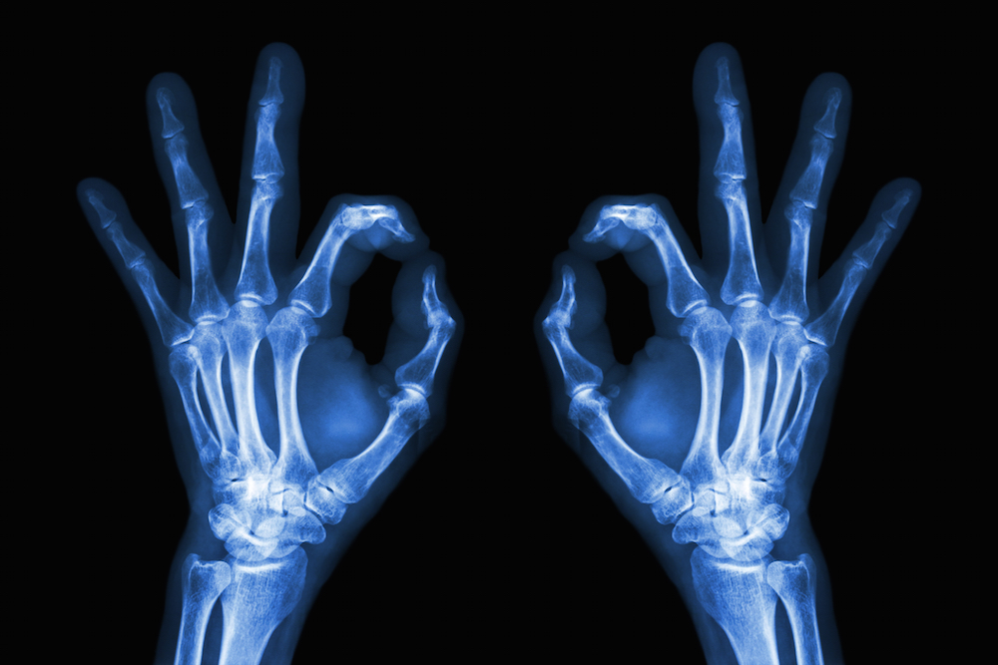
BONE | OSTE(O)
OSTEOMA | A BONY TUMOR

Slide 16
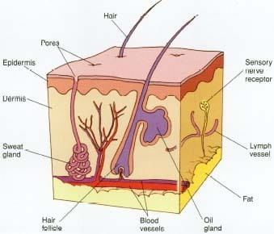
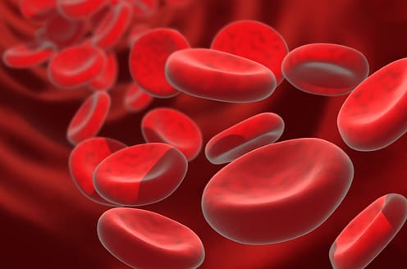
SKIN | DERM | EPIDERMIS
BLOOD VESSELS | ANGI(O) | ANGIOPLASTY

Slide 17
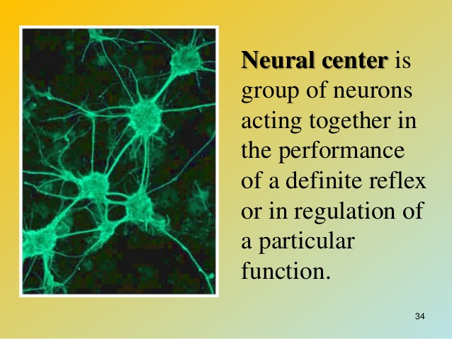
NERVE | NEUR(O)
NEURON | NERALGIA

Slide 18
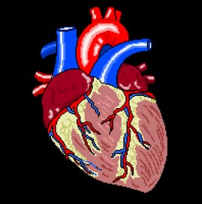
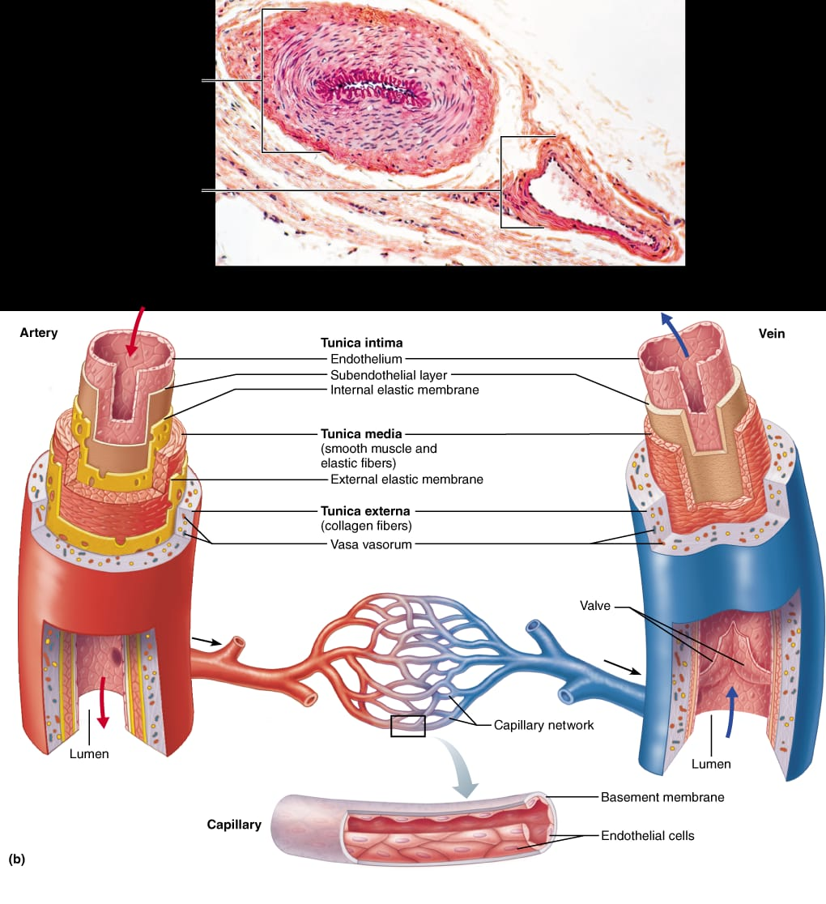
HERAT | CARDIO
VESSELS / VEIN | PHLEBO

